Slide 1


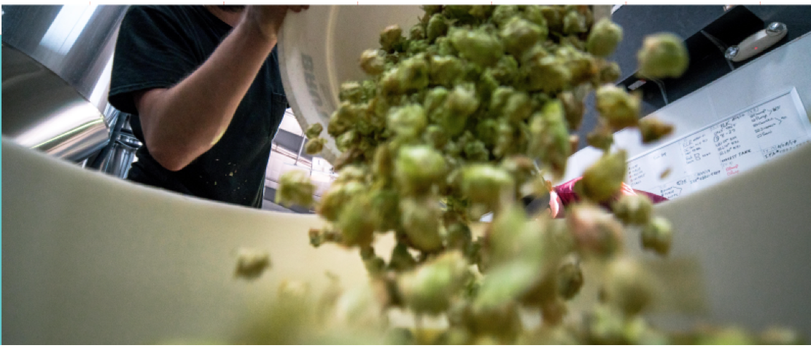
Europe-India Innovation Partnership
Thematic Platform for Start-ups
Food waste

Slide 2
EU-India Innovation Partnership
Thematic Platform for Start-ups
Background
Funded by the European Commission Directorate-General for Research and Innovation and with support from the India government, the EU-India Innovation Partnership was launched in 2018 to build a network and connect the incubator ecosystems in India and Europe.
At present we have more than 90 Indian and European incubators and accelerators participating in the initiative and offering support to each other’s portfolio start-ups and scale ups to explore market opportunities in the others region. We are still expanding this network. More info at: https://startupeuropeindia.net/eiip/
A major flagship initiative being implemented within the EU-India incubator network focuses on new agri-technologies and how they can be leveraged to reduce food waste from farm to consumer. We are already collecting and standardizing information about business initiatives on food waste being supported by the participating incubators.
Thus we are currently reaching out to private (corporates) and public sector stakeholders interested in being involved in supporting start-ups from Europe and India developing and deploying solutions for food waste reduction from farm to consumer.

Slide 3


Positioning of the food waste initiative in the EU-India Innovation Partnership
Start-ups
incubator
incubator
incubator
incubator
Corporate and public sponsors
Food Waste Initiative
This structure could in the future be expanded to other global challenges such as: Climate Change
incubator
incubator
incubator
incubator
Start-ups

Slide 4
EU-India Innovation Partnership
Thematic Platform for Start-ups
Why incubators and food waste ?
Food waste is a major issue of sustainable development. It directly affects the lives of many people. In India about 40% of all food is wasted often already in the distribution chain.
Today we see many entrepreneurial initiatives to combat food waste using a variety of technologies. Many of them will not survive because of the wrong product market fit, not able to cross the valley of dead or the wrong team. Getting the right exposure is difficult.
On the other hand, we see governments, corporates and investors looking for innovative idea’s but having difficulties in identifying good quality propositions.
Quality incubators can play a role to connect the ecosystems:
They select, control and mentor start-ups and scale ups to achieve quality.
They offer a beachhead and support for each others start-ups, reducing the risk of entering new territory. They help to overcome cultural issues.
They understand the local environment and can help start-ups to connect to the local ecosystem reducing time to market.
They join forces and act as multipliers to support each others start-up communities and provide market access.

Slide 5
EU-India Innovation Partnership
Thematic Challenges for Start-ups
Technologies used to tackle food waste……..
Iot, Artificial intelligence
Sensors
Platforms
Augmented reality
Blockchain
Tracking software
QR codes
Facial recognition
Robots
Solar panels
New fuels
5 G
Water purification
Plant based coatings
Recyclable packages
Cooling techniques
Biodegradable materials
Biogas
Solar foods
Drones
Mobile apps
Virtual reality
Lasers

Slide 6
EU-India Innovation Partnership
Thematic Challenges for Start-ups
Ambition
To promote the wide range of initiatives by start ups and scale ups focused on technical solutions and concepts to reduce food waste and make them transparent
To do this by creating a database of standardized information about every start- and scale-up and develop programs for exchange, market entry and cooperation
To draw the attention of corporates, governments and investors looking for new ideas
We aim at start ups and scale ups already selected, quality-checked and mentored by incubators, to begin with in India and Europe but not limited to this
To develop a set of rules of engagement for all participants in the initiative to make cooperation and exchange of information easier.
But above all; to make real impact and join forces to help reduce food waste

Slide 7
EU-India Innovation Partnership
Thematic Challenges for Start-ups
We seek cooperation
We have been working on these initiatives for a few years and have created the basis for cooperation and the attention for food waste. We have access to the incubator ecosystems in India and Europe but we want to enlarge and speed up the initiative.
We need:
To actively identify, evaluate and promote initiatives on food waste and make them transparent
To keep the information accessible and up to date
To approach selected incubators to join the initiative
To stimulate the exchange of information and collaboration between European and Indian start-ups to create new technology-based products and services to tackle food waste
To identify corporate partners who are interested to join and help promote the initiative

Slide 8


EU-India Innovation Partnership
Thematic Challenges for Start-ups
Who we are
This initiative is run by the European Commission’s Service Facility for International Cooperation. In this capacity, the Europe-India Innovation Partnership is facilitated by the following organisations:
Technopolis is a 25-year-old consultancy with expertise in policy strategy, implementation and evaluation. We specialise in research and innovation, science and technology policy and operate across the globe, with 14 offices in 12 countries in Europe, Latin America and Africa. Our international clients include: The European Commission, World Bank, African Development Bank, OECD, UNESCO, UNIDO, MasterCard Foundation, etc. As well as the Europe-India Innovation Partnership, we also facilitate the Africa-Europe Innovation Partnership, which operates on a similar model.
Global Business Inroads is a boutique International Business and Project Management Consulting Entity, based in India with a specialization in facilitating cross border technology, business and research cooperation, best practice exchange and exposure to researchers and business leaders. GBI has expertise in assisting highly innovative technology companies from India and around the world internationalize into new / emerging markets by helping clients identify new market and business opportunities.

Slide 9
Thematic Challenge Area: Food / Agri waste technologies that reduce waste from farm to market
EU-India
Consolidated Food waste Start-up Deck
13 incubators from the network submitted 44 start-ups profiles (27 from India & 17 from Europe) to date (more are added on an ongoing basis).
The start-ups in the deck have been grouped into 5 sub-themes: Smart Farming, Food Processing, Logistics and Packaging, Supply Chain Management, and Waste Management and Recycling

Slide 10
EU-India
Consolidated Food waste Start-up Deck
List of European start-ups
Country | Start-up
Belgium – France – Luxembourg | WANAKA - Agroptimize
Belgium – Luxembourg | SmileBin
Denmark | UpFood
Estonia | Festera Bioboxes OÜ (wastefox)
France | Comerso
France | Résurrection
France | PRECIFIELD
France | Newcy
France | Hoali
Country | Start-up
France | Les cuisiniers solidaires
France | Pandobac
France | Fourmize
France | Cosse nature
Luxembourg | OKO Finance
Luxembourg | WEO
Luxembourg | Food4all
Poland | Waste-Lab

Slide 11
EU-India
Consolidated Food waste Start-up Deck
List of Indian start-ups
Start-up
Agastya Buoyant Pvt.ltd | Desi V Desi​ | Krishiacharya technologies Pvt. Ltd. (Bijak)
Agsmartic Technologies (P) LTD | DesiMati​ | Loopworm Private Ltd
AI-Genix International Pvt. Ltd.​ | ECSO Global Pvt. Ltd. (AbsoluteFoods) | New Leaf Dynamic Technologies (P) LTD
Agrilinks Data Technologies Pvt. Ltd. | Farm-junction marketing Pvt. Ltd | Oddy Uniwrap​
Aquamen Fisheries Private Limited | FRUTUNES FOOD PRODUCTS (P) ltd | Orayna Solutions Pvt LTD​
Bee Basket Enterprise Pvt Ltd​ | Greenjoules Pvt. Ltd.​ | Ravikas
Brickcells Technologies Pvt Ltd​ | Impensus Electronics pvt Ltd | Shambhala Food Products Private Limited
Connedit Business Solutions Pvt. Ltd. | Indicold Private Limited | Vasumitra Life Energies Pvt. Ltd.
Craste | Klonec Automation Systems Pvt. Ltd. | Yuhansh Farm Solutions Private Limited​

Slide 12
For Thematic Challenge Area: Food / Agri waste technologies that reduce waste from farm to market
EU-India Startup pitch template

Slide 13
Company Logo
Sector
Product / Solution / Technology – pictures
Company Name:
Country:
Founded:
Website:
USP of the Product / Solution / Technology: How does it contribute to tackling food waste? (One sentence)
About the company and Product /Solution / Technologies. (100 words max):
Clientele: XXXXXXXXX
Additional links / YouTube / etc

Slide 14
Proposed Plan of Action - The compiled list of start-ups will be shared with private and public sector stakeholders, including corporates. This will be a more powerful compilation than incubators approaching them one by one. - It is of interest to corporates and governments to be aware of innovations from Europe and India that can solve problems and help initiate new business areas - The goal is for the startups to work together on demonstration, projects, business and collaboration opportunities, with support from corporate and public sector sponsors. - The Europe – India Innovation Partnership Service Facility will aim to facilitate such deployment projects in India and Europe for innovations to be utilized with appropriate business models in new markets
EU-India Innovation Partnership
Thematic Challenges for Start-ups

